Slide 1



NEURAL NETWORK AND
POLAR CODE DESIGN
Batsari Vasiliki
Milasheusi Usevalad
Rezaei Kiarash
Ruan Francesco

Slide 2
Outline:
Brief Explanation of Polar Codes
Constraints of the project
Implementation Phases
Phase I: Dataset Generation
Phase II: Data Pre-processing
Phase III: Neural Network Design
Performance Metric
Evaluation over network parameters
Phase IV: FER prediction
Results
Conclusion

Slide 3
Purpose of the project
Improve the efficiency of Polar Codes for SCL decoder
Using the Neural Network to find the best position of frozen bits for a specific SNR
Analyze the behavior of the new polar code with different SNR
Evaluate the performance of the generated frozen bit set

Slide 4
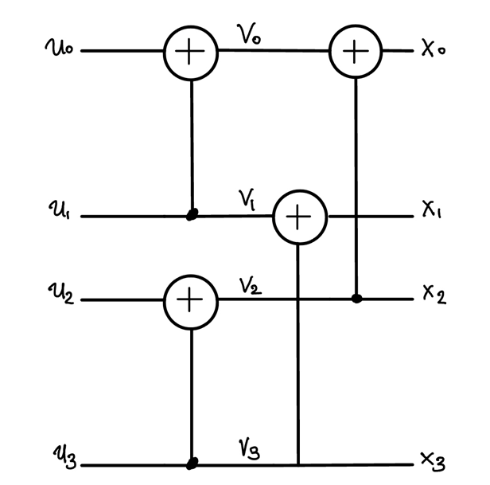
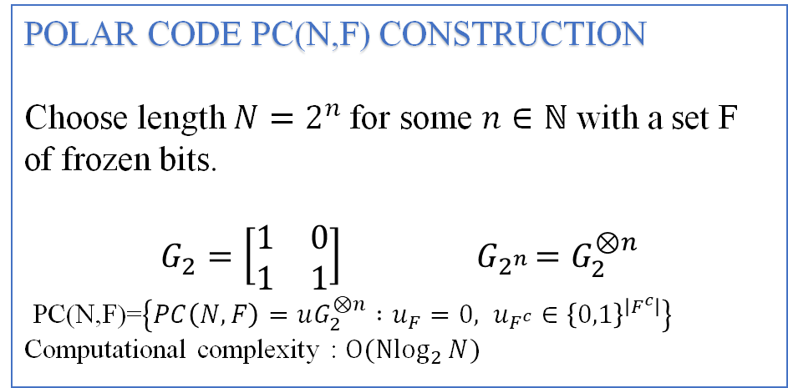
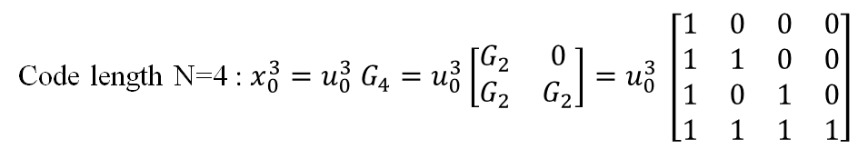
Polar Code
Linear Block error-correcting code
Implemented using a generator matrix in a recursive way
POLAR CODE PC(N,F) CONSTRUCTION
Choose length $N=2^{n}$for some $n∈ℕ$ with a set F of frozen bits.
$$G_{2}=\left[\begin{matrix}1 & 0 \\ 1 & 1\end{matrix}\right]{ G}_{2^{n}}=G_{2}^{⊗n}$$
PC(N,F)=$\left\{PC\left(N,F\right)=uG_{2}^{⊗n} :u_{F}=0, u_{F^{c}}∈{\left\{0,1\right\}}^{\left|F^{c}\right|}\right\}$
Computational complexity : ${O(Nlog}_{2}{N})$
Code length N=4 : $x_{0}^{3}=u_{0}^{3} G_{4}=u_{0}^{3}\left[\begin{matrix}G_{2} & 0 \\ G_{2} & G_{2}\end{matrix}\right]=u_{0}^{3} \left[\begin{matrix}1 & 0 & 0 & 0 \\ 1 & 1 & 0 & 0 \\ 1 & 0 & 1 & 0 \\ 1 & 1 & 1 & 1\end{matrix}\right]$

Slide 5
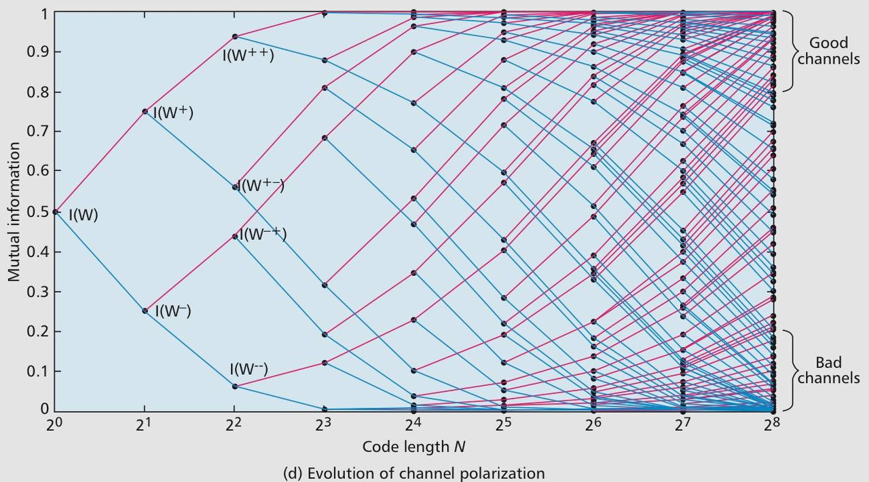
POLAR CODE
N-implementation of the polar transformation can polarize the channel, splitting it in virtual channels.
Reliable channels will improve constantly
Bad channels will tend to have worst reliability

Slide 6

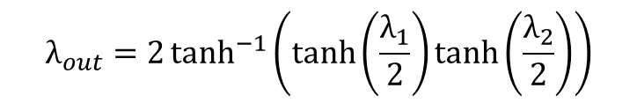










SC Decoder
- Decoder $D^{+}$:
-Decoder $D^{−}$:
$$λ_{1}$$
$λ_{1}$ and $λ_{2}$are two log-likelihood ratio and $on bit û∊(0,1)$.
$λ_{out}={\left(−1\right)}^{û}$ $λ_{1}{+λ}_{2}$
$$û$$
$$D^{+}$$
$$λ_{out}$$
$$λ_{2}$$
$$λ_{1}$$
$$D^{−}$$
$$λ_{out}=2\tanh^{−1}\left(\tanh\left(\frac{λ_{1}}{2}\right)\tanh\left(\frac{λ_{2}}{2}\right)\right)$$
$$λ_{out}$$
$$λ_{2}$$

Slide 7
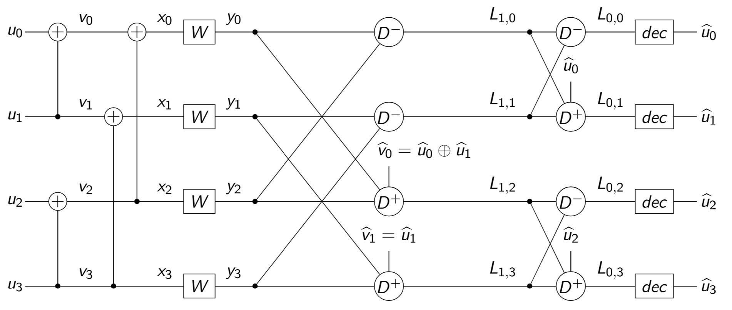

SC Decoder
The process of decoding each u is not run in parallel but it has a specific order.
Main idea:
$$û_{0}=û_{0}(Y_{0}^{3})$$
$$û_{1}=û_{1}(Y_{0}^{3},û_{0})$$
$$û_{2}=\left(Y_{0}^{3},û_{0}^{1}\right)$$
$$û_{3}=(Y_{0}^{3},û_{0}^{2})$$

Slide 8
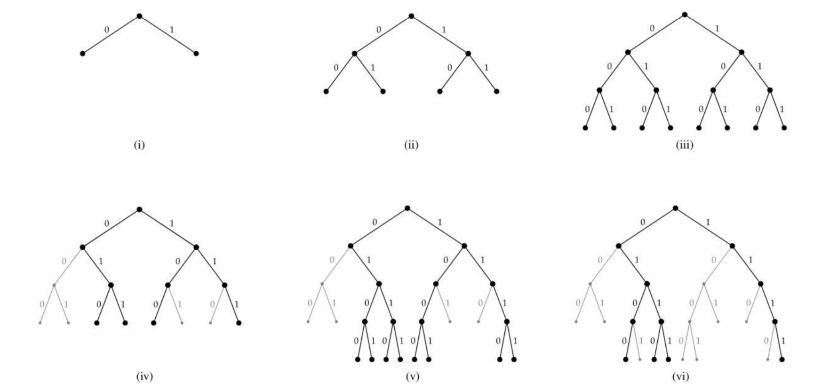

Successive Cancellation List(SCL)
It takes in consideration both option of $û_{i}$, either it is 0 or 1.
A path is set of decision on past bits $û_{i}^{i−1 }$for 0≤ i <N.
For each path we associate a specific path metric
We have a finite list where we collect L path and discard path with the largest metrics.
The output of the decoder is a the codeword with the smallest path metric

Slide 9
Project Constraints
Payload (# of information bits) = 64 Bytes
Rate = 1/2
Target SNR = 2.7 dB
Dataset generation method : Gaussian Approximation's permutations
FER computation is based on Monte Carlo simulation
The decoder is Successive Cancellation List (SCL) with L parameter equal to 32
* Although we could not provide results for other large codes (Payload = 256, 1K bytes), due to hardware resource limitations, the approach is the same

Slide 10
Implementation Phases:
Phase I: Dataset Generation
Phase II: Data Pre-processing
Phase III: Neural Network Design
Phase IV: FER Prediction

Slide 11
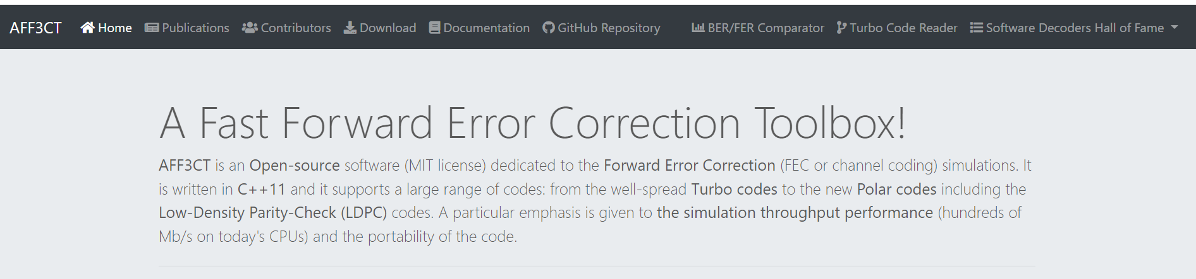
Phase I: Dataset Generation
Aff3ct is a Fast Forward Error Correction simulator
It implements Monte Carlo simulation
Given a sequence of frozen and information bits' positions as input, it provides us with its FER and BER for a specific SNR or a range of SNR

Slide 12
Phase I: Dataset Generation
Starting from a frozen bitset for Gaussian approximation (GA), using Python, we applied several random bit permutations in order to get the required number of samples.
We created ~15K sequences of 1024 bits each, as inputs for the toolbox (payload K = 64 bytes).
By using the AFF3CT toolbox and some bash scripting, we obtained the corresponding FERs, according to the given parameters.

Slide 13
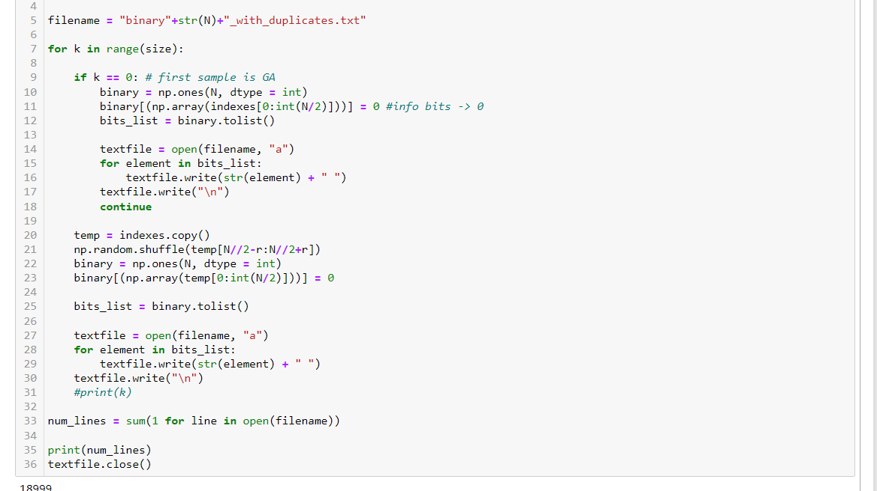

Slide 14
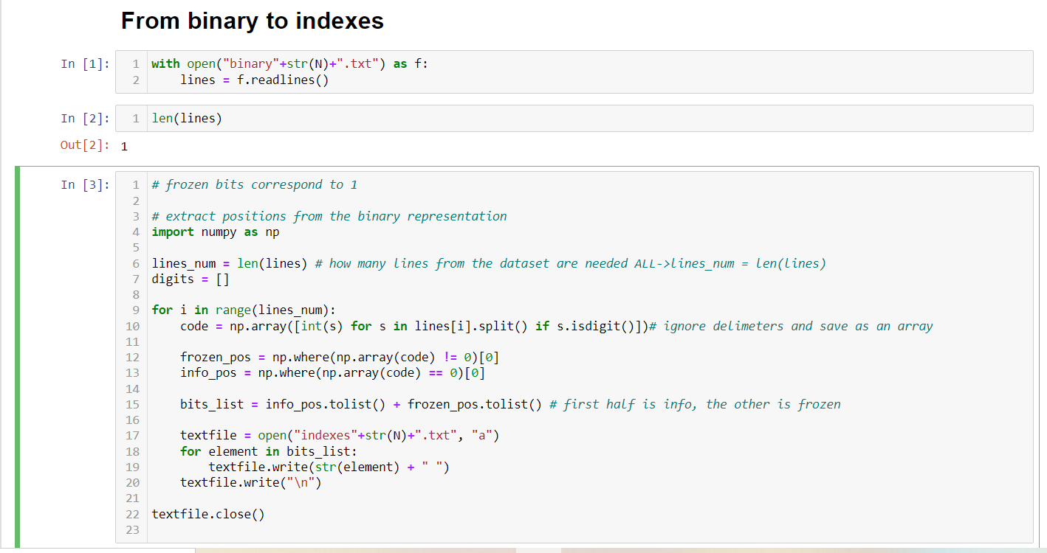

Slide 15
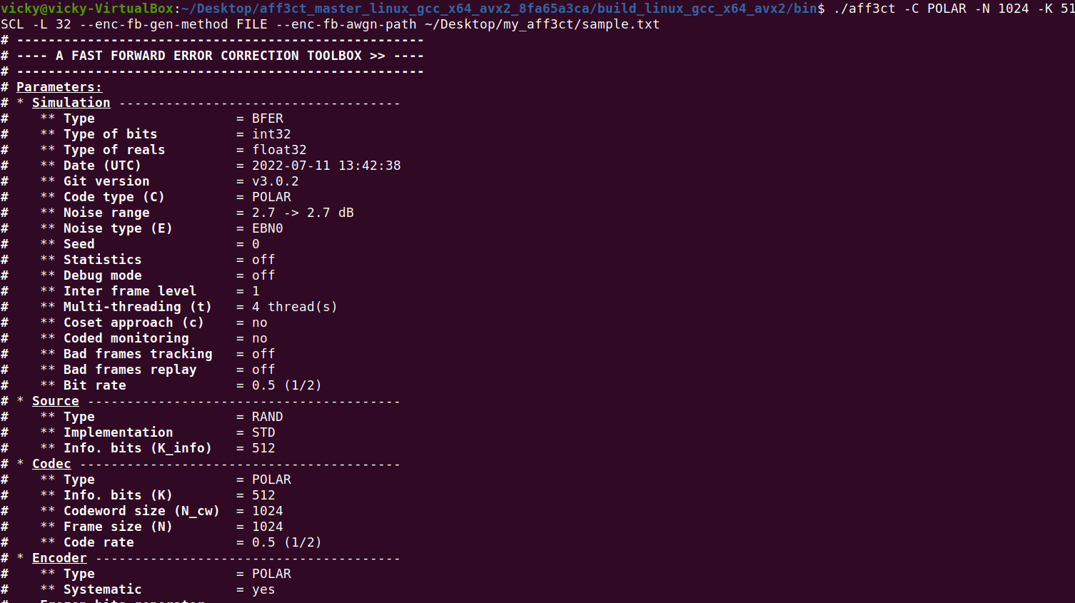

Slide 16
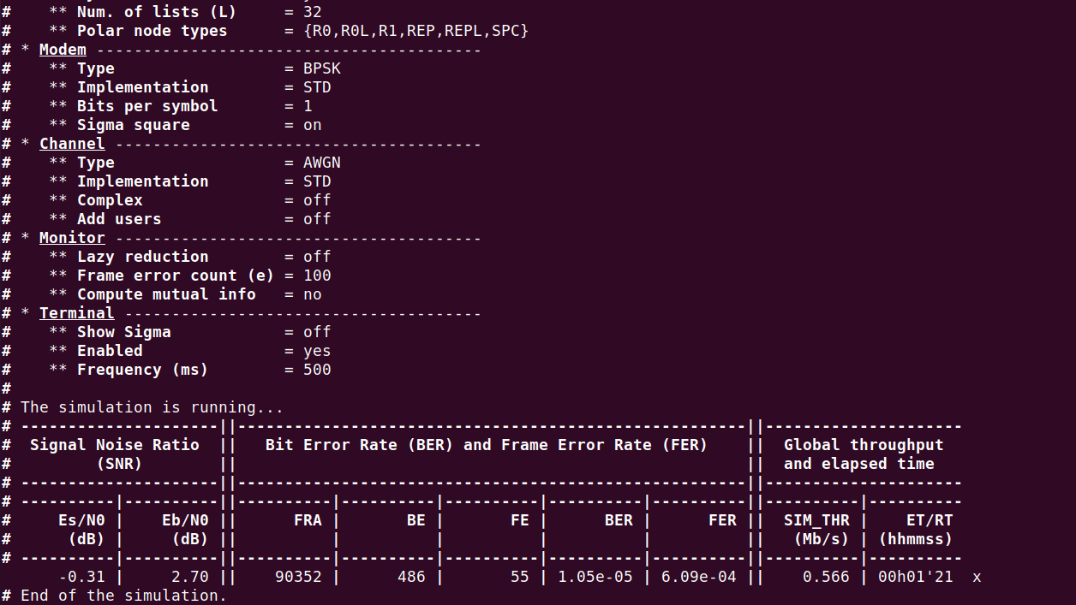

Slide 17
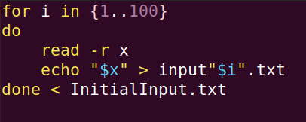
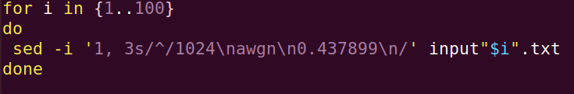
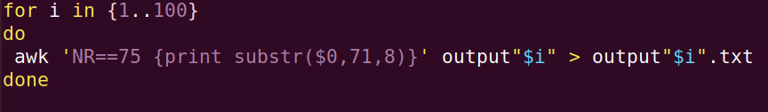
Bash Scripting...

Slide 18

Phase I: Dataset Generation
The results had really high FER ( ~ 0.9), even if we tried to generate the input sequences with many different ways.
So, we could not use them to feed the neural network, as the latter would not be able to generalize and give us an optimal output.
Taking, however, as inputs, the sequences of the paper provided to us, we extracted the same results as it did, which could serve as an input in our neural network.
Thus, we replicated the paper's results, taking the same samples of bit-sequences and corresponding FERs.

Slide 19
Phase II: Data Pre-processing
We have separated the input dataset into bit sequences dataset and corresponding FER dataset
Each bit with value 1 is a frozen bit and each one with value 0 is an information bit
The Mean value and standard deviation (STD) for each position of bits is computed.
We call the positions with STD not equal to zero, varying bit positions (for each sample)
Standardization function: we standardize varying bits [(Bit – Mean(Bit) )/ STD] and use them as the new training set
Now for the new training and validation sets, info bit values are equal to –1 and frozen bit values are equal to 1 and the dimension reduced to the number of position of varying bits

Slide 20
Phase II: Data Pre-processing
REASON: to bring down all the features to a common scale without distorting the differences in the range of the values. Also, reducing the dimension and use the features(varying bits) that affect the performance in order not to feed the model with useless data in training process

Slide 21
Phase II: Data Pre-processing
PAYLOAD = 64 Bytes
Size of training set: 12689 samples
Size of validation set: 3173 samples
Number of varying bit positions: 112

Slide 22
Phase III: Neural Network Design
Training:
We used MSE as the loss function and Adam optimizer for learning rate optimization.
The approach is to predict FERs for each batch (batch_size= 32, to reduce the computation time) of input data. Computing the loss function, updating the gradients and learning rate afterwards in an iterative process

Slide 23

Performance Metric
In order to evaluate the performance of the neural network, inflation of error (IOE) was used as a metric, which indicates how inaccurate the output is with respect to the true value
Ex. IOE is 5%, which means our model undershoots / overshoots by 5 percent wrt. the ground truth

Slide 24
Evaluation over the Network Parameters
We have investigated the effect of changing the following parameters on the performance of our network to optimize its performance. Thus, we test the network based on them.
The number of Epochs
The number of layers (Depth)
The number of Skip connections
The number of neurons in hidden layers
​
​
​
​
​
​

Slide 25
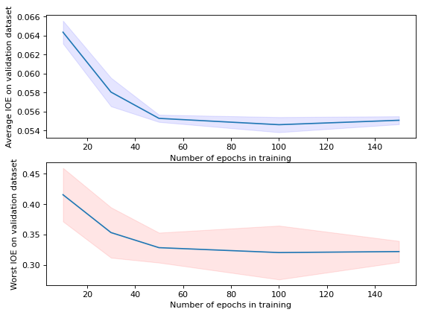
Evaluation of IOE over the number of epochs:
* Confidence bound over 5 runs

Slide 26
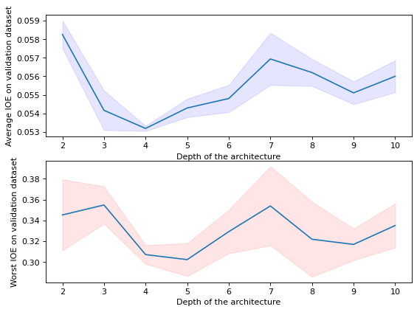
Evaluation of IOE over the number of layers(depth):
* Confidence bound over 5 runs

Slide 27
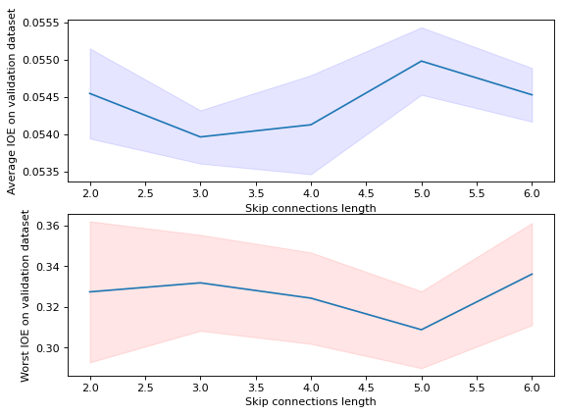
Evaluation of IOE over the length of skip connections:
* Confidence bound over 5 runs

Slide 28
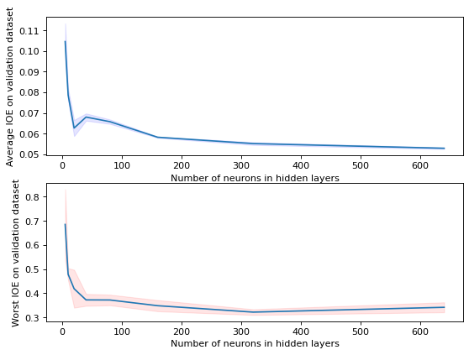
Evaluation of IOE over the number of neurons in hidden layers:
* Confidence bound over 5 runs

Slide 29
Phase IV: FER Prediction
In order to predict an optimal frozen bit set two following methods were used:
"Projected Gradient Descent " and "Random Search" algorithms. Abstract explanation for both of them is to find the input such that the output of the function (NN in our case) is maximized.

Slide 30
Phase IV: FER Prediction
Random Search: using an ensemble of several pretrained networks, for a given amount of time we input 1000 random string of bits (maintaining R = ½) and acquire a set of FERs corresponding to the input. By taking the average by an ensemble , we store the minimal FER predicted. This process is repeated for a fixed amount of time.

Slide 31
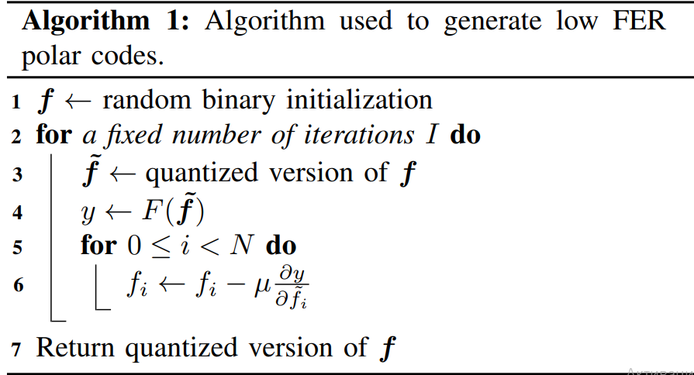
Phase IV: FER Prediction
Projected Gradient Descent(PGD). Previously described method is very straight forward and does not use any heuristics whatsoever. In this method, having frozen the parameters of the network, we treat the input as a parameter which we update using SGD in order to find the global minimum. The parameters inputted are the number of iterations to be performed and the learning rate.
Generally, we generate new varying bits and use them as the input of the trained network in order to fool it

Slide 32
Phase IV: FER Prediction
The parameters of the model used for frozen bitset generation are:
Depth: 3
Hidden layer size: 640 neurons
Skip gaps: 3
Trained on 100 epochs
Lamda = 0.1
# iterations = 2000

Slide 33
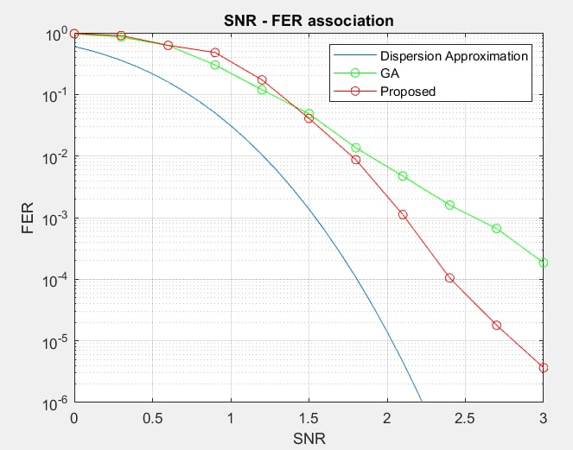
Results:
The proposed sequence has an FER equal to 1.79e-05, for SNR = 2.7 dB
, dB

Slide 34
Conclusion
The proposed frozen bit set which is driven for target SNR = 2.7 dB, can give us reliable results even for other values of SNR. It is closer to the lower limit and has a better performance than our initial assumption on GA, since it requires smaller SNR for the same value of FER.

